Slide 1
Custom Vision Service
[ Instructor Name ]
[ Instructor E-mail ]

Slide 2
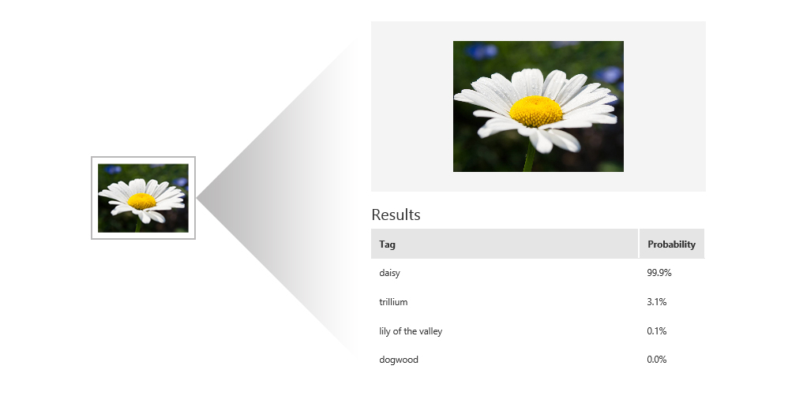
Custom Vision Service
Custom Vision Service leverages the power of machine learning to create and customize state-of-the-art computer vision image recognition models by exposing tools and APIs to build custom image classifiers to training and predict images.
Notes:
As part of the Microsoft Cognitive Services suite, Custom Vision Service is designed to allow users and developers to customize thier own state-of-the-art computer vision models for unique industry or scenario-specific cases.
Custom Vision Service is accessed via the Custom Vision Service portal at https://customvision.ai/ and exposes a rich set of REST-based APIs for both training and prediction.

Slide 3
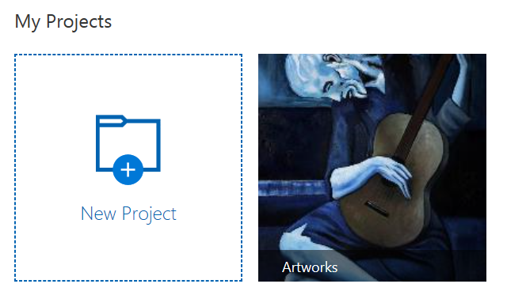
Classifiers and Projects
A classifier is a model you build using Custom Vision Service, by using a few training images. Each classifier you build is in its own project.
Classifier = Project
Notes:
The terms “classifier” and “project”, although not technically the same, are used throughout the Custom Vision Service documentation to reference the same technical concept: A logical grouping of images, tags, and training iterations.

Slide 4
Domains
When you create a project, you select a domain for that project. The domain optimizes a classifier for a specific type of object in your images.
Food Optimized for dishes you would see on a restaurant menu.
Landmark Optimized for recognizable landmarks, both natural and artificial.
Retail Optimized for classifying images in a shopping catalog or shopping website.
Adult Optimized to better define between adult content and non-adult content.
Notes:
A “domain” optimizes a classifier for a specific type of object in images. For example, if a scenario is to classify between images of buttermilk pie versus images of Bundt cake, then a user would select the "Food" domain. If users are unsure of which domain to choose, the would typically just select the "Generic" domain.

Slide 5
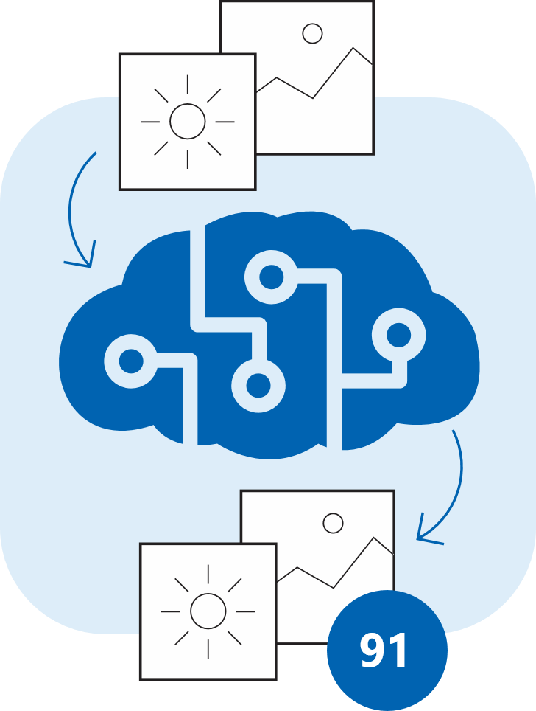
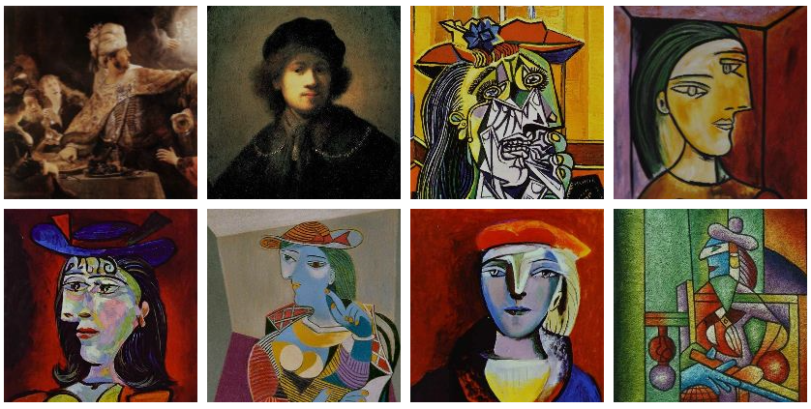
Training Images
To create a high precision classifier, Custom Vision Service needs several training images. A training image is a photograph of the image you want Custom Vision Service to classify.
Notes:
To create a high precision classifier, Custom Vision Service needs several training images. A training image is a photograph of the image you want Custom Vision Service to classify. For example, to classify pineapples, you would need to upload several images of pineapples to Custom Vision Service to allow the service to create a classifier that can recognize oranges. Although not required, the Custom Vision Service recommends using a minimum of 30 images per tag.

Slide 6
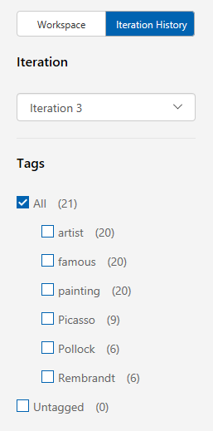
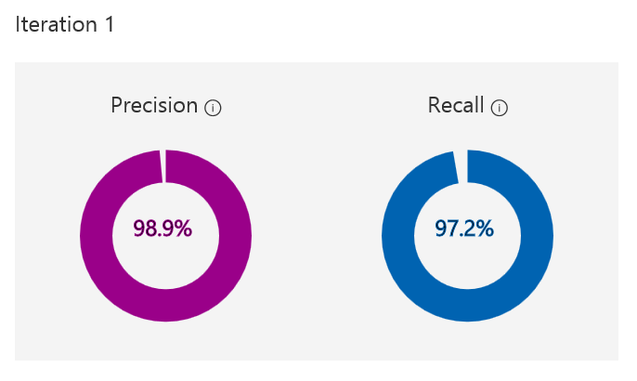

Iteration
Every time you Train or re-train your classifier, you create a new iteration of your model.
Notes:
Every time you train or re-train your classifier, you create a new iteration of your model. Custom Vision Service maintains several past iterations to allow users to compare your progress over time. Users can delete any iteration at any point, if an iteration is no longer deemed useful. Important: Deleting an iteration is permanent, and also deletes any images or changes that were unique to that iteration.

Slide 7
Important Terms
Precision When you classify an image, how likely is your classifier to correctly classify the image? Out of all images used to train the classifier (Picasso, Rembrandt, and Pollock), what percent did the model get correct? 99 correct tags out of 100 images gives a Precision of 99%.
Recall Out of all images that should have been classified correctly, how many did your classifier identify correctly? A Recall of 100% would mean, if there were 12 Picasso paintings in the images used to train the classifier, 12 Picasso paintings were found by the classifier.
Notes:
The terms “precision” and “recall” may seem similar at first glance. Although these terms are related, they each describe a specific aspect of a classifier training.

Slide 8
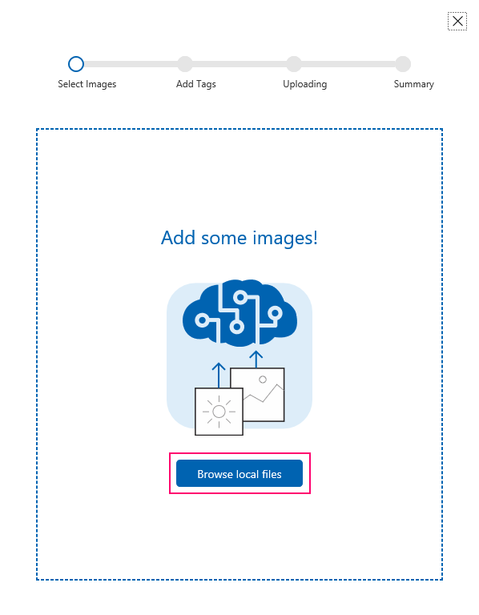
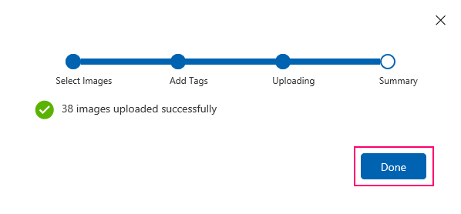
Building a Classifier
Create a project
Select a domain
Add images
Assign tags to images
Train the classifier
Evaluate the classifier
Notes:
Building a classifier is essentially the process of creating a project. Project creation can occur via the Custom Vision Service portal, or via the REST-based Training API. All essential aspects of building classifiers (or creating and managing projects) can be achieved via the REST API.

Slide 9
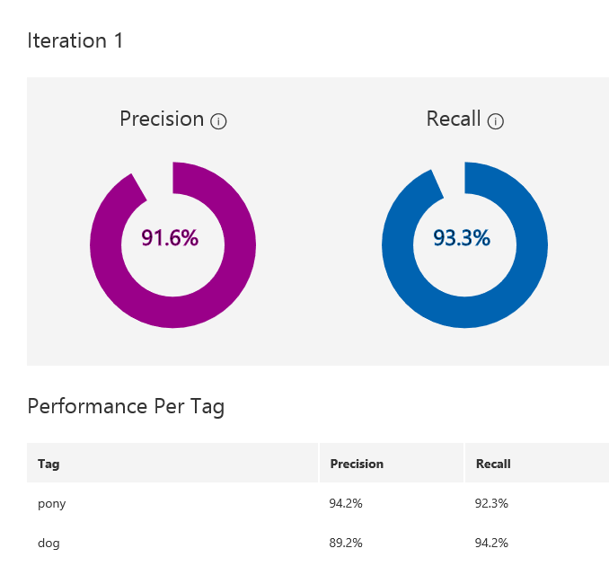
Improving a Classifier
The best way to have a quality classifier is to add more varied tagged images (different backgrounds, angles, object size, groups of photos, and variants of types.) Always to train your classifier after you have added more images. Include images that are representative of what your classifier will encounter in the real world. Photos in context are better than photos of objects in front of neutral backgrounds, for example.
Notes:
There are a large number of ways to improve the accuracy and reliability of a classifier, many of which require initial human interaction. The primary way to improve a classifier is to add more varied and tagged images. Over time, consistent image tagging is the most reliable way to improve a classifier.
A classifier will learn characteristics that photos have in common, not necessarily the characteristics a user is thinking of. For example, if all your daffodils were photographed outdoors in a field, and all the tulips were photographed in front of a blue wall in a red vase, you have likely trained a “field vs wall+vase” classifier, not daffodils vs tulips.

Slide 10
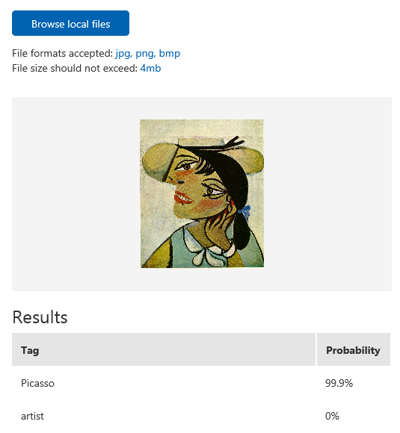
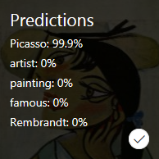
Testing a Model
After you train your model, you can quickly test it using a locally stored image or an online image. The test uses the most recently trained iteration.
Notes:
Adding single images before retraining a model doesn't lead to significant performance gains. For best results, users should add a significant number of images before retraining.
The most useful tool for evaluating potential adjustments to a model training is the use of the Predictions tab in the Custom Vision Service portal.

Slide 11
Commonly Used APIs
Training
Prediction
Create images
Tag images
Create projects
Manage projects
Manage iterations
Create tags
Get account information
Train a project
Predict images
Predict and save images
Predict image URLs
Predict and save image URLs
Notes:
Virtually all methods and features necessary to create end-to-end Custom Vision Service solutions are possible via the Custom Vision Service REST APIs. The Custom Vision Service APIs are categorized into two (2) groupings:
Training APIs
Prediction APIs
All account and project management APIs are grouped under training, as a separate “management” API is not currently available.

Slide 12
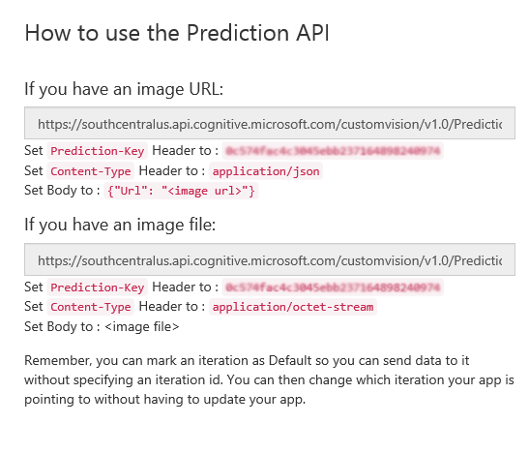
Using the Prediction API
After a successful training, the Custom Vision Service can be accessed via an endpoint that references the Project Identifier, as long as the appropriate Prediction Key is passed in the request header.
Notes:
Unlike most other Cognitive Service offerings, Custom Vision Service management is not currently accessed via the Azure portal, but is instead managed via the Custom Vision Service portal. Instead of using a “subscription key”, Custom Vision Service APIs use either a “Training Key” or a “Prediction Key” depending on the APIs being used.
The appropriate endpoint is determined via a combination of a location-specific URL, combined with a user-specific project identifier: ProjectId
API authentication occurs via a standard HTTPS request header, appropriately populated with either a Training Key or Prediction Key.

Slide 13
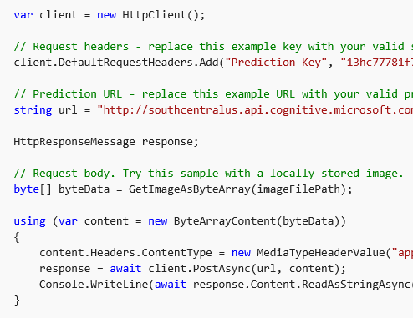
Prediction API REST Concepts
All actions related to the Custom Vision Service are accessed via standard REST-based methods, such as GET and POST against an API endpoint, making it simple to use the Prediction API on any platform or with any programming language.
Notes:
Since the Custom Vision Service APIs are REST-based, use of the APIs can occur via any tool or programming language that can make simple HTTPS requests. Like all REST APIs, the action verb typically controls the activity, such as GET, POST, PUT, and DELETE.
Many of the Custom Vision Service APIs expose “variations” of methods. For example: Images can be predicted by sending the API an external available URL OR sending the API the actual file (binary) representation of the image.

Slide 14
Hands-On Lab
Custom Vision Service HOL.html

